Slide 1

Utilization of collected Data
by Paras Garg
pgarg2@stevens.edu http://paras-garg.info
Notes:
Hi, I am Paras Garg, going to present on Utilization of Collected Data

Slide 2
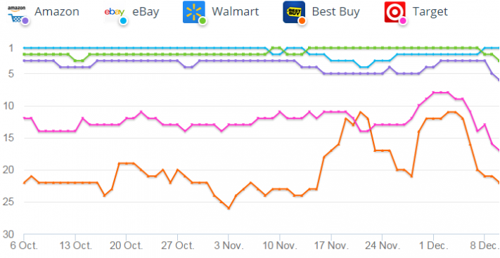
Why companies collect data?
Traffic Tracking
Users Segmentation
Marketing and Sales
Product Performance
Conversion Rates
Notes:
Why do companies spend so much money in collecting data?
Data plays a significant role in their decision making as it capture every activity by users. So, eventually it helps them to understand their customers. Some of the possible reasons that the companies collect huge amount of data as they want to know user activities, user behavior, to trace product performance, to promote sales, and to know the conversion rates.
Now, let’s discuss some of the strategies.

Slide 3
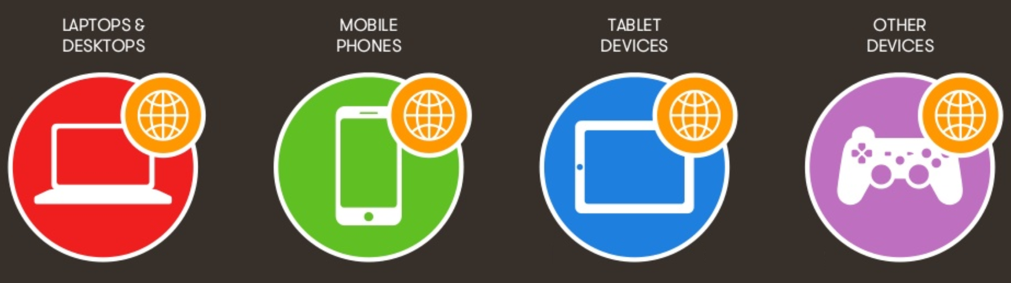
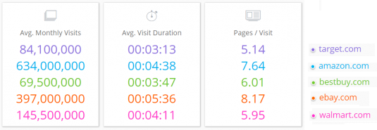
Traffic Tracking
Target Device
Traffic Source
Average Visits
Average Duration
Click Throughs
Notes:
Traffic tracking is one of the most important strategies as it provides a clear picture on incoming traffic, users interests, user behavior and other user activities.
Using this strategy company can monitor the user devices: to know most common device among users, traffic sources: what are sources they are receiving traffic it could be blogs, advertisement, posts, or any other webpage, check average number of visits and duration user spent on any particular page or post to understand user interests, and check click throughs so they can detect the time of a day the most of the users are active.
How companies can use this information?
Any company like Amazon could have thousands for web links and sources which drives the user on their website. So, this strategy helps Amazon to find out top links or posts from which the company receives a quality traffic.

Slide 4
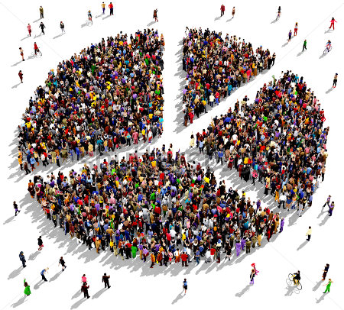
Users Segmentation
Geographic: country, region, city, location, etc.
Demographic: age, gender, income, occupation, marital status, etc.
Psychographic: lifestyle, interests, opinions, etc.
Behavioristic: brand loyal, brand switchers, heavy users, etc.
Notes:
In this strategy, company divides the users in to groups based on there geographic location, users characteristics, user psychology, and user behavior.
These information help the companies to understand their actual users - who they are, what are their needs, things they don’t care about, and the ways they compare products.
How this strategy is helpful?
Suppose there are two phones iPhone and Samsung and company has collected the enough information which tells, that iPhone has great demand at East coast and Samsung has demand at West coast. By this information, company will divide the users geographically. Now, they can build the strategy to promote these products based on locations.

Slide 5

Marketing and Sales
Up Sale / Cross Sale
Recent Searches
Suggestions
Advertisements
Promotions / Newsletters
Notes:
This strategy helps the company to increase their sales and conversion rates.
Companies utilize data for products up sales and cross sales, enhance search results based on users searches, to maximize advertisement benefits and for product promotions.
Company collect user searches and based on that it shows similar products, products which others customers had bought with particular products, and even send newsletters.

